Slide 1
Census Bureau’s Urban and Rural Classification and Overview of 2020 Urban Area Criteria
New Jersey State Data Center Affiliate Meeting
September 22, 2022
Michael Ratcliffe
Geography Division
U.S. Census Bureau
The views expressed in this presentation are those of the author and not necessarily those of the U.S. Census Bureau.

Slide 2
Introduction
The history of the Census Bureau’s urban-rural classification since the late-19th century has been one of response to:
  Changes to settlement patterns in and around cities.
  Changes in theoretical approaches to interpreting and understanding the growth of urban areas.
  Improved technology (i.e., GIS, digital databases) making it easier to manage large amounts of data.
  Increased spatial resolution of statistical and geospatial data.
  For information on the history of the Census Bureau’s urban and rural classification, see: “A Century of Delineating a Changing Landscape,” https://www2.census.gov/geo/pdfs/reference/ua/Century_of_Defining_Urban.pdf

Slide 3
Census Bureau Urban Area Classification: 1950 Census
Urbanized area concept adopted to identify densely settled territory adjacent to cities of 50,000 or more people.
Noncontiguous, high-density areas included, but linking corridors (“jumps”) were not classified as urban.
Census designated places (CDPs) adopted.
Outside urbanized areas, incorporated places and CDPs of 2,500 or more people classified as urban.

Slide 4
1950 Census urbanized area delineation: Baltimore, MD
Non-contiguous qualifying territory added on north and south

Slide 5
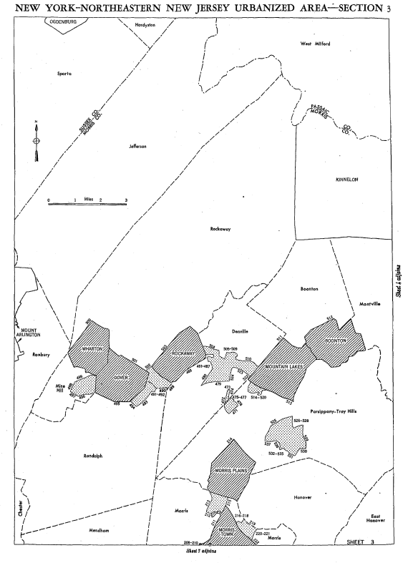
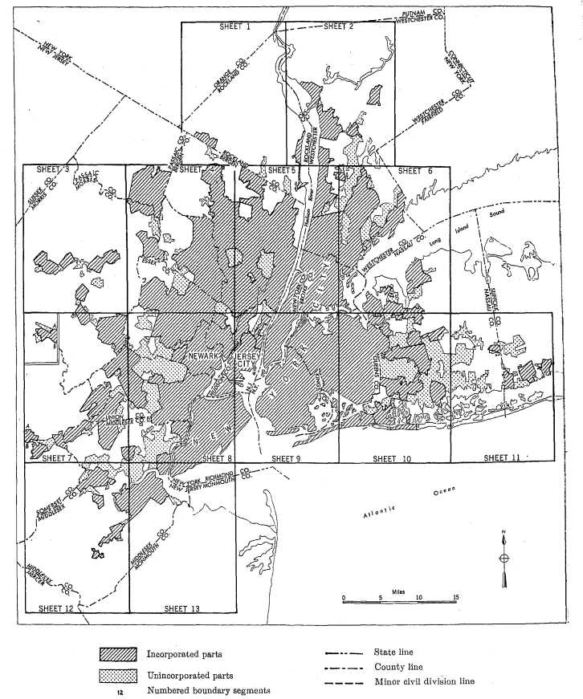
1950 Census urbanized area delineation: New York-Northeastern New Jersey
Non-contiguous qualifying territory

Slide 6
Urban Areas: 1960 through 1990
Basic concepts and criteria remain unchanged;
Interactive, paper map-based delineation.
Previous decade’s boundary provided the starting point for delineation.
Analysis units are places, enumeration districts and “small enumeration districts.”
Central place criteria changes, mainly affecting requirements to initiate delineation (i.e., twin cities totaling 50,000 or more population).
Jump concept is implemented as a guideline. Intervening, low-density corridor included in area.
1970: adoption of extended city concept.

Slide 7
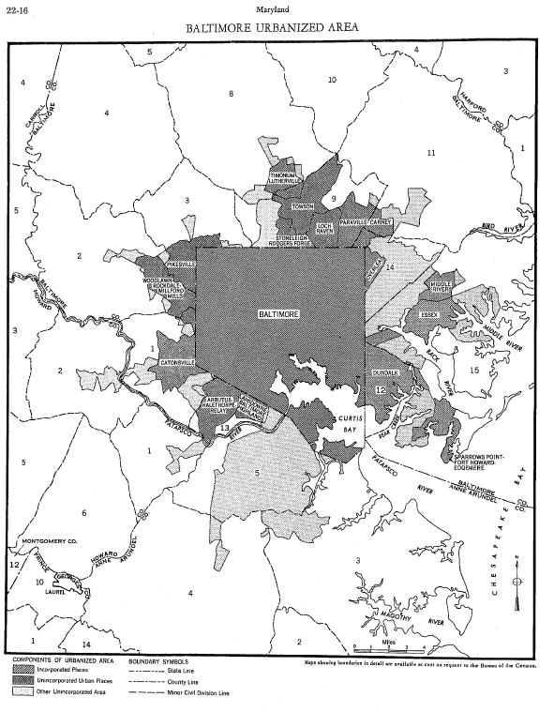
1960 urbanized area delineation: Baltimore, MD
Continuous area; that is, low-density “jump corridors” to reach outlying densely settled areas are included in the urbanized area.
CDPs defined outside Baltimore city.

Slide 8
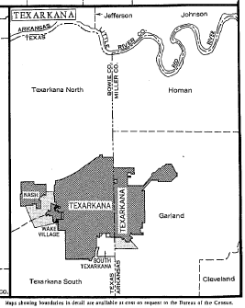
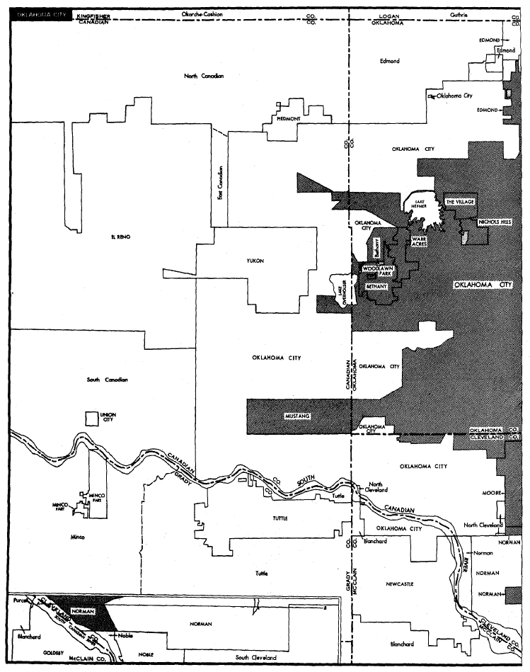
Urban Area Criteria Changes, 1960-1990
Rural portions of Oklahoma City
1960 Census: Twin central cities totaling 50,000 or more persons.
1970 Census: “Extended cities” split between urban and rural components.

Slide 9
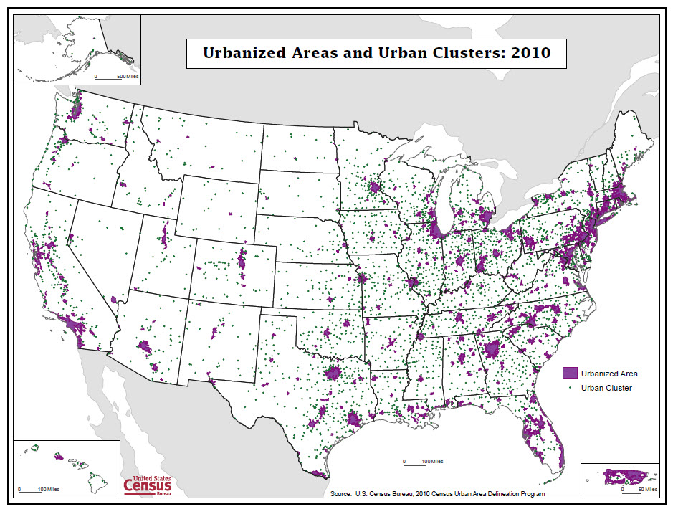
Census Bureau Urban Areas: 2010 Definition
Urbanized areas: 50,000 or more population.
Urban clusters: at least 2,500 and less than 50,000 population.
Defined primarily based on population density measured at the census tract and census block levels.
  Initial urban core: at least 1,000 per square mile
  Remainder of urban area: at least 500 per square mile
 | 2010 Census Population | 2010 Percent | 2020 ACS 5-year Population Estimates* | 2020 Percent
Total | 308,745,538 | 100.0 | 326,569,308 | 100.00
Urban | 249,253,271 | 80.7 | 263,366,402 | 80.7
Rural | 59,492,267 | 19.3 | 63,202,906 | 19.3
*2020 ACS estimates for urban areas are based on urban area boundaries defined in 2010 and do not account for new urbanization that occurred outside those boundaries between 2010 and 2020.
Sources: 2010 Census; 2016-2020 ACS 5-year data.
9

Slide 10
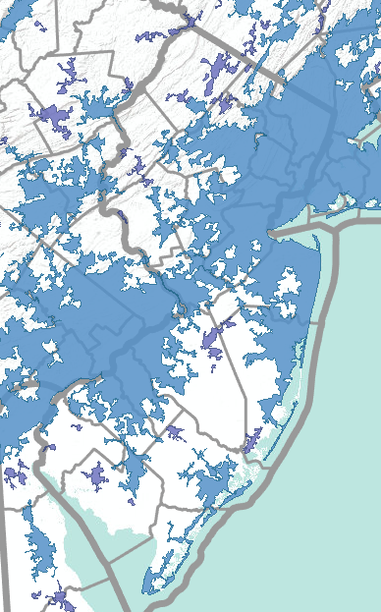
New Jersey Urban Areas:
2010 Definition
 | 2010 Census Population | 2010 Percent | 2020 ACS 5-year Population Estimates* | 2020 Percent
Total | 8,791,894 | 100.0 | 8,885,418 | 100.0
Urban | 8,324,126 | 94.7 | 8,473,163 | 95.4
Rural | 467,768 | 5.3 | 412,255 | 4.6
Sources: 2010 Census; 2016-2020 ACS 5-year data.
*2020 ACS estimates for urban areas are based on urban area boundaries defined in 2010 and do not account for new urbanization that occurred outside those boundaries between 2010 and 2020.
10

Slide 11
Census Bureau Urban Areas (2020 Census criteria)
Urban Areas of at least 2,000 housing units or at least 5,000 people.
Defined primarily based on housing unit density measured at the census block level.
  Initial urban core: at least 425 housing units per square mile
  Remainder of urban area: at least 200 housing units per square mile
  At least one high density nucleus of at least 1,275 housing units per square mile required for qualification.

Slide 12
Key Changes to Urban Area Criteria
Minimum threshold for qualification as urban: at least 2,000 housing units or at least 5,000 population. Increased from a minimum of 2,500 persons.
Use of housing unit density at the census block level instead of population density.
No longer distinguish between urbanized areas of 50,000 or more population and urban clusters of less than 50,000 persons.
Maximum distance for “jumping” across low-density intervening territory reduced from 2.5 miles to 1.5 miles (return to the jump distance that was in effect from 1950 through 1990).
Will not include the intervening low-density “hop” and “jump” corridors in the urban area. This results in noncontiguous urban areas.
Splitting continuous urban agglomerations based on commuting patterns (using Longitudinal Employer-Household Dynamics [LEHD] data).

Slide 13
Change to Thresholds for Qualifying as an Urban Area
Minimum threshold for qualification as urban: at least 2,000 housing units or at least 5,000 population. Increased from a minimum of 2,500 persons.
  2,500-person threshold had been in use since 1910.
  Census Bureau’s threshold was the lowest in use in various agencies’ urban/rural definitions.
  Rural stakeholders and analysts have questioned the continued validity of the 2,500-person threshold and have routinely asked if we would consider an increase. Most recently, the Western Governors’ Association asked us to consider raising the threshold to 10,000 persons.
Impact:
    Approximately 1,000 areas in the US would shift from urban to rural status (based on 2016-2020 ACS 5-year data). These areas contained an estimated 3.5 million people in 2020 (ACS 2016-2020 5-year estimates).

Slide 14
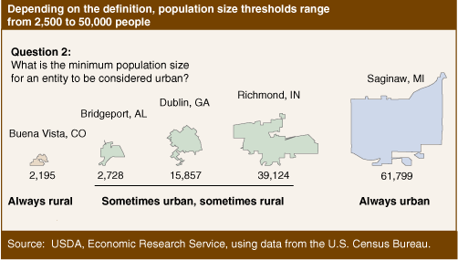
What is the minimum population size for an entity to be considered urban? Different federal agencies use different thresholds.
Source: Cromartie and Bucholtz (2008), “Defining the ‘Rural’ in Rural America.”
USDA ERS - Defining the “Rural” in Rural America

Slide 15
Why 2,500 persons?
The Census Bureau officially adopted the 2,500-person threshold as the minimum population for an urban place in 1910.
  Truesdell, 1949: “For the census of 1910 the definition of urban population [2,500 persons] presented in the [1906] Statistical Analysis was adopted, again without any discussion of its merits as compared with those which had been used earlier; and this definition has been used, with minor modifications, in later censuses down to and including 1940.”
From 1874 to 1900:
  1874: 8,000-person threshold was used to identify urban cities and towns.
  1880: 4,000-person threshold. “It seemed to be the opinion of the officials in charge of the census in 1880 that the 8,000 limit was too high to include all of the population that was really urban in character.” (Truesdell, 1949).
  1890: back to 8,000 persons.
  1900: 4,000-person threshold used in reports.
Source: Leon Truesdell, 1949. “The Development of the Urban-Rural Classification in the United States: 1874 to 1949.” Current Population Reports, P-23, Number 1.

Slide 16
All other changes to criteria and population distribution aside, the change to the minimum threshold will result in an increase in rural population.
Urban and Rural Population
Based on 2010 Threshold
Urban and Rural Populations
Based on 2020 Thresholds
Applied to Current Urban Areas
 | 2016-2020 ACS 5-year Population Estimates | 2020 Percent
United States | 326,569,308 | 100.0
Urban | 263,366,402 | 80.7
Rural | 63,202,906 | 19.3
 | 2016-2020 ACS 5-year Population Estimates | 2020 Percent
United States | 326,569,308 | 100.0
Urban | 259,850,930 | 79.6
Rural | 66,718,378 | 20.4
Source: 2016-2020 ACS 5-year data.

Slide 17
All other changes to criteria and population distribution aside, the change to the minimum threshold will result in an increase in rural population.
Urban and Rural Population
Based on 2010 Threshold
Urban and Rural Populations
Based on 2020 Thresholds
Applied to Current Urban Areas
 | 2020 ACS 5-year Population Estimates | 2020 Percent
New Jersey | 8,885,418 | 100.00
Urban | 8,473,163 | 95.4
Rural | 412,255 | 4.6
 | 2020 ACS 5-year Population Estimates | 2020 Percent
New Jersey | 8,885,418 | 100.00
Urban | 8,459,472 | 95.2
Rural | 425,946 | 4.8
Source: 2016-2020 ACS 5-year data.

Slide 18
Urban areas that had 2010 Census populations of 2,500 up to 9,999, as a category, lost population between 2010 and 2020. All other size categories experienced population increases.
Sources: 2010 Census; 2016-2020 ACS 5-year data.

Slide 19
Housing Unit Density
More direct measure of developed landscape
Census block-level housing unit counts are invariant
Ability to update extent of Urban Areas between censuses
425 housing units per square mile (HPSM) for initial cores
200 HPSM to fill in extent of urban areas
1,275 HPSM to ensure each urban area has a high-density nucleus
200 HPSM = 500 persons per square mile (PPSM), based on national average of 2.5 persons per housing unit
425 HPSM = 1,062 PPSM
1,275 HPSM = 3,188 PPSM

Slide 20
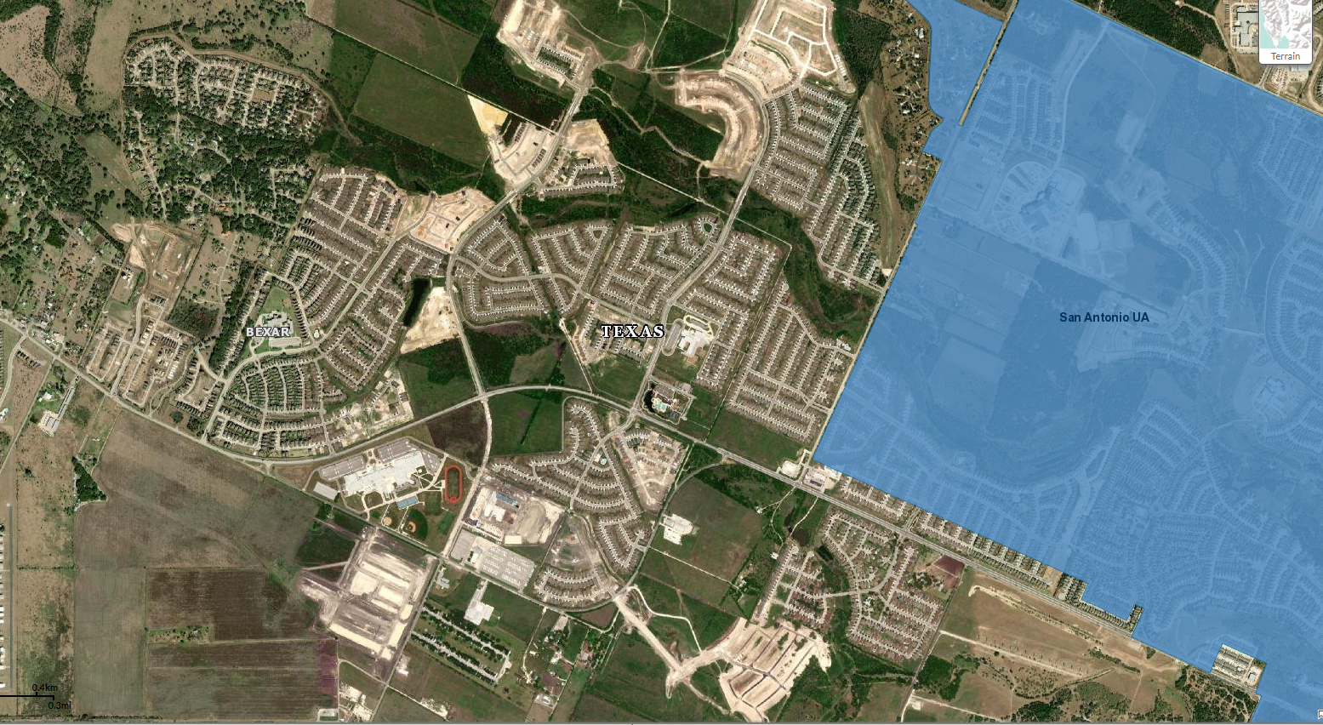
Use of housing unit density at the census block-level provides the ability to update urban area boundaries between censuses.
Post-2010 development on the west side of the San Antonio urban area. Because urban areas are not updated between censuses, the population and housing in this and similar areas was treated as rural in American Community Survey and other statistical data products.

Slide 21
No Longer Distinguish Between Types of Urban Areas
No longer distinguish between urbanized areas of 50,000 or more population and urban clusters of less than 50,000 persons.
  No clear scientific basis for use of 50,000 as a threshold distinguishing different types of urban areas.
  The decision to adopt 50,000 as a threshold for urbanized areas starting in 1950 seems to have been based more on operational concerns and data availability than rooted in economic data or central place theory.
  Urban areas between 40,000 and 51,000 population are similar in terms of economic activity.
  Still possible for data users and agencies to identify areas based on various sizes of population.
Impact: The term “Census Bureau-defined urbanized areas” is used in legislation and program documentation without specific reference to population size since urbanized areas, by definition, had a minimum population of 50,000. These references will have to be revised to “… urban areas of 50,000 or more…” or interpreted to mean areas of 50,000 or more persons.

Slide 22
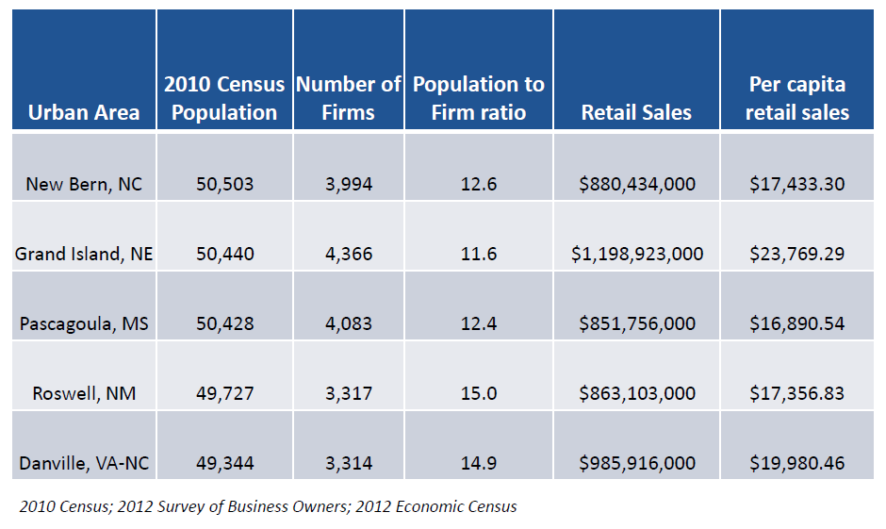
Urban areas with populations just above or just below the 50,000-person threshold do not differ substantially in terms of economic activity, as measured by numbers of firms and retail sales.
Data for each urban area are based on the aggregation of data for places located within the urban area (Economic Census data are not tabulated for urban areas).

Slide 23
Change to Jump Distance and Inclusion of Intervening Low-Density Territory
Maximum distance for “jumping” across low-density intervening territory reduced from 2.5 miles to 1.5 miles (return to the jump distance that was in effect from 1950 through 1990).
Will not include the intervening low-density “hop” and “jump” corridors in the urban area. This results in noncontiguous urban areas.
Impact:
Will reduce the amount of land area within individual urban areas. This will have a positive impact on the measurement of the extent of urbanization and urban sprawl.
Will affect the total population of individual urban areas. A small number of areas might drop below 50,000 persons as a result.
Creation of noncontiguous areas adds complexity when using our areas.
  Use of geographic information systems mitigates the complexity of working with complicated boundaries.

Slide 24
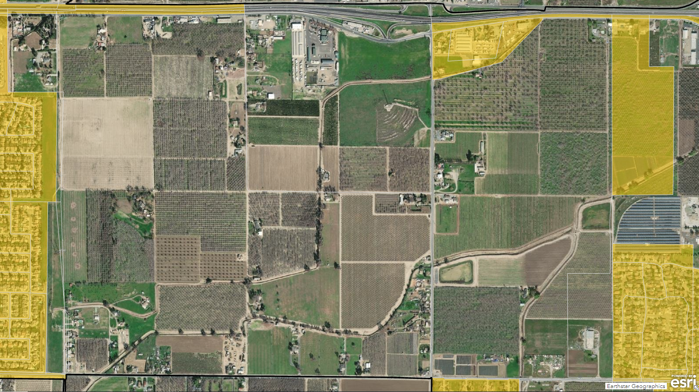
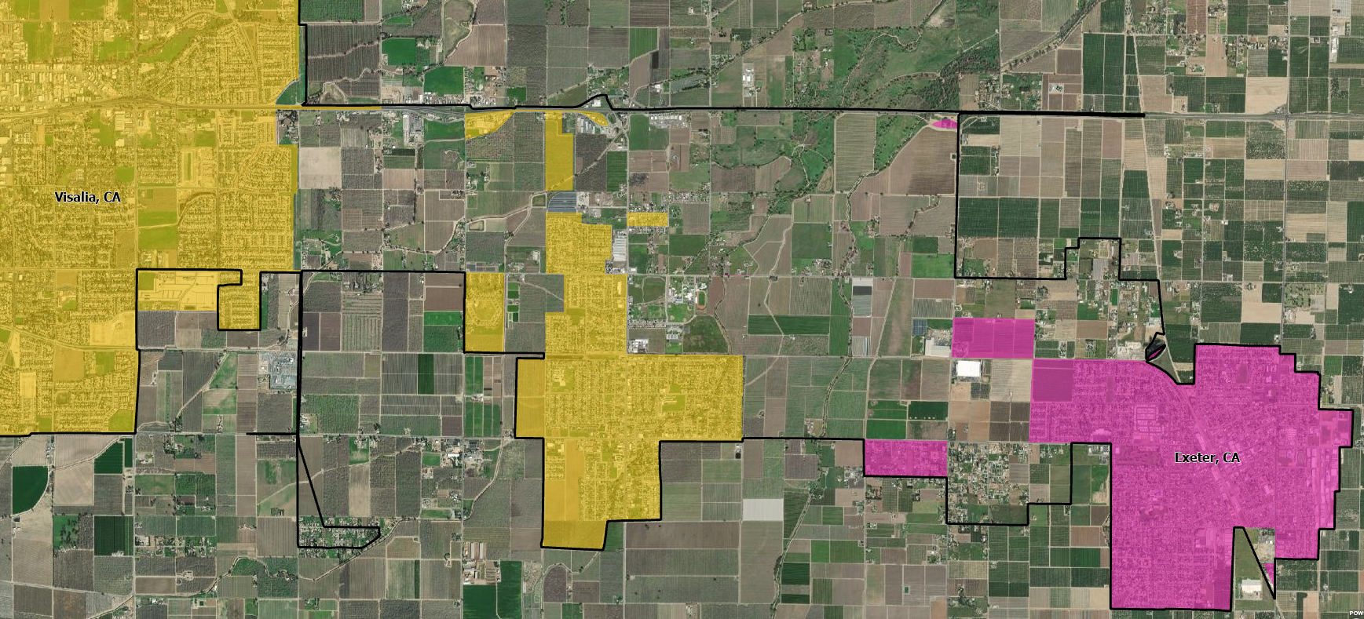
By not including hop and jump corridors, low-density areas with typically rural land uses will not be included in the urban area, resulting in a more accurate delineation.

Slide 25
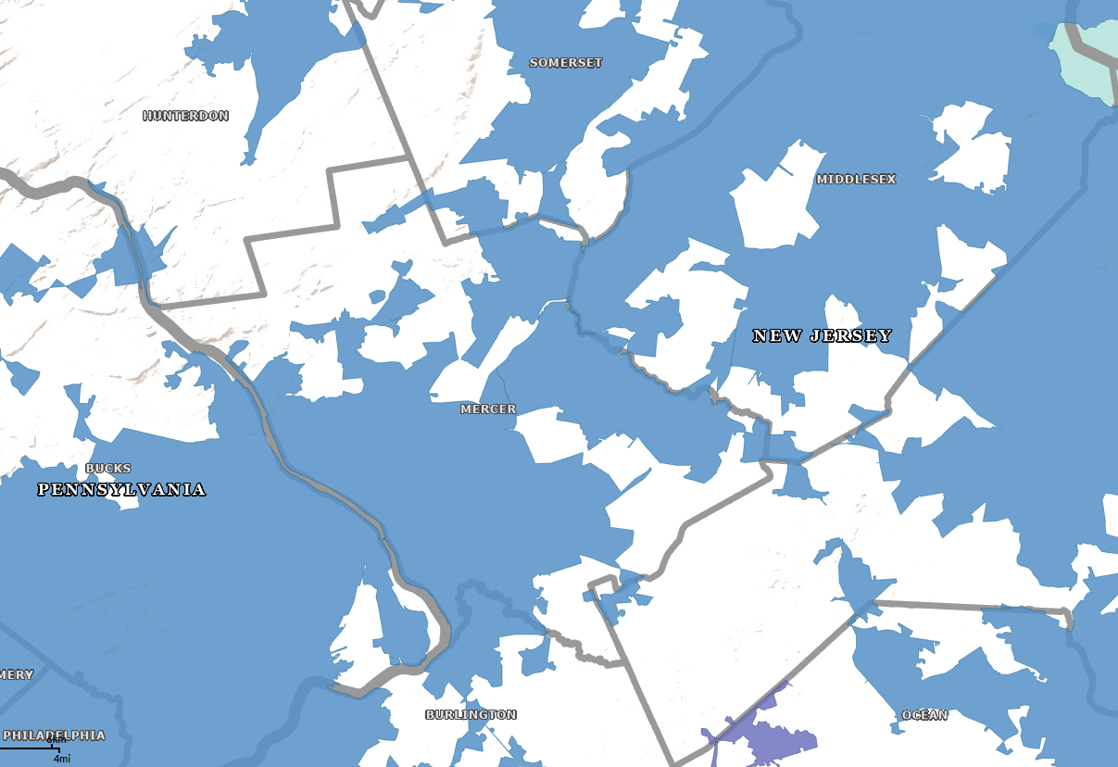
Splitting Urban Agglomerations
The delineation process results in large agglomerations encompassing multiple, individual urban areas. The question each decade is how, and where, to split these large agglomerations to define more recognizable and meaningful areas for analysis.
  Previous decades’ delineations relied on metropolitan area definitions (which had been based on the previous decade’s urban area boundaries) or where the connecting corridor was narrowest. None of these approaches were data driven.
For 2020, we will use the Longitudinal Employer-Household Dynamic (LEHD) Origin-Destination (LODES) dataset to analyze commuting patterns and determine whether to split agglomerations and, if so, where to draw the boundary.
Contiguous urban areas in the central New Jersey.

Slide 26
Initial Qualification
Hops and Jumps
Low Density Fill
Final Qualification
Merging
Urban Area Aggregations
Splitting
Naming
Urban Area Delineation Process

Slide 27
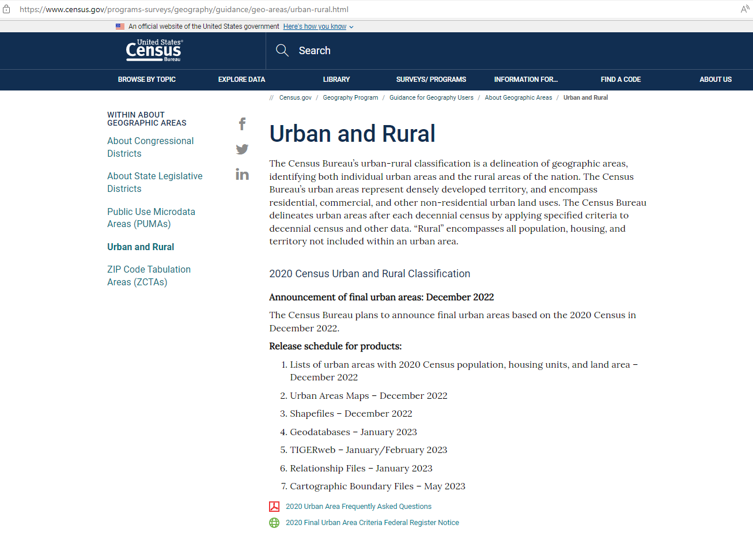
For more information:

Slide 28
Thank You. Questions?
Michael Ratcliffe
Senior Advisor
Geography Division
michael.r.ratcliffe@census.gov

